Slide 1
Assertion Methods
Prepared by Chala Urgessa

Slide 2
Assertions in Test Cases
During execution of a test case:
If an assertion is true,
Execution continues
If any assertion is false,
Execution of the test case stops
The test case fails
If an unexpected exception is encountered,
The verdict of the test case is an error.
If all assertions were true,
The test case passes.

Slide 3
Assertion Methods: Boolean Conditions
Static methods defined in org.junit.Assert
Assert a Boolean condition is true or false
assertTrue(condition)
assertFalse(condition)
Optionally, include a failure message
assertTrue(message, condition)
assertFalse(message, condition)
Examples
assertTrue(search(a, 3) == 1);
assertFalse(“Failure: 2 is not in array.”, search(a, 2) >= 0);

Slide 4
Assertion Methods: Null Objects
Assert an object references is null or non-null
assertNull(object)
assertNotNull(object)
With a failure message
assertNull(message, object)
assertNotNull(message, object)
Examples
assertNotNull(”Should not be null.", new Object());
assertNull(”Should be null.", null);

Slide 5
Assertion Methods: Object Identity
Assert two object references are identical
assertSame(expected, actual)
True if: expected == actual
assertNotSame(expected, actual)
True if: expected != actual
The order does not affect the comparison,
But, affects the message when it fails
With a failure message
assertSame(message, expected, actual)
assertNotSame(message, expected, actual)

Slide 6
Assertion Methods: Object Identity
Examples
assertNotSame("Should not be same.",
new Object(), new Object());
Integer num1 = Integer.valueOf(2013);
assertSame("Should be same.", num1, num1);
Integer num2 = Integer.valueOf(2014);
assertSame("Should be same.", num1, num2);
java.lang.AssertionError:
Should be same. expected same:<2013> was not:<2014>

Slide 7
Assertion Methods: Object Equality
Assert two objects are equal:
assertEquals(expected, actual)
True if: expected.equals( actual )
Relies on the equals() method
Up to the class under test to define a suitable equals() method.
With a failure message
assertEquals(message, expected, actual)

Slide 8
Assertion Methods: Object Equality
Examples
assertEquals("Should be equal.", "JUnit", "JUnit");
assertEquals("Should be equal.", "JUnit", "Java");
org.junit.ComparisonFailure:
Should be equal. expected:<J[Unit]> but was:<J[ava]>

Slide 9
Assertion Methods: Equality of Arrays
Assert two arrays are equal:
assertArrayEquals(expected, actual)
arrays must have same length
Recursively check for each valid index i,
assertEquals(expected[i],actual[i])
or
assertArrayEquals(expected,actual)
With a failure message
assertArrayEquals(message, expected, actual)

Slide 10
Assertion Methods: Equality of Arrays
Examples
int[] a1 = { 2, 3, 5, 7 };
int[] a2 = { 2, 3, 5, 7 };
assertArrayEquals("Should be equal", a1, a2);
int[][] a11 = { { 2, 3 }, { 5, 7 }, { 11, 13 } };
int[][] a12 = { { 2, 3 }, { 5, 7 }, { 11, 13 } };
assertArrayEquals("Should be equal", a11, a12);

Slide 11
Assertion Methods: Floating Point Values
For comparing floating point values (double or float)
assertEquals requires an additional parameter delta.
assertEquals(expected, actual, delta)
assertEquals(message, expected, actual, delta)
The assertion evaluates to true if
Math.abs( expected – actual ) <= delta
Example:
double d1 = 100.0, d2 = 99.99995;
assertEquals(“Should be equal within delta.”, d1, d2, 0.0001);

Slide 12
Exception Testing
A.k.a., robustness testing
The expected outcome of a test is an exception.
checkedSearch(null, 1);
public static int checkedSearch(int[] a, int x) {
if (a == null || a.length == 0)
throw
new IllegalArgumentException("Null or empty array.");
…
}

Slide 13
Exception Testing: Specify the Excepted Exception
Specify an expected exception in a test case
A particular class of exception is expected to occur
The verdict
Pass: if the expected exception is thrown
Fail: if no exception, or an unexpected exception
@Test
void exceptionTesting() {
Exception exception = assertThrows(ArithmeticException.class, () ->
calculator.divide(1, 0));
assertEquals("/ by zero", exception.getMessage());
}

Slide 14
Exception Testing: The fail() Assertion
Assertion methods
fail()
fail(message)
Unconditional failure
i.e., it always fails if it is executed
Used in where it should not be reached
e.g., after a statement, in which an exception should have been thrown.

Slide 15
Exception Testing: Use fail() Assertion
Catch exceptions, and use fail() if not thrown
Allows
inspecting specific messages/details of the exception
distinguishing different types of exceptions
@Test
public void testCheckedSearch3() {
try {
checkedSearch(null, 1);
fail("Exception should have occurred");
} catch (IllegalArgumentException e) {
assertEquals(e.getMessage(), "Null or empty array.");
}
}

Slide 16
Ignoring Tests
If you want to temporarily disable a test case (this might come up if you have test cases for parts of your program that aren’t fully implemented yet, for instance), you can do so by putting @Disabled above @Test.
When running tests, JUnit will distinguish between tests that pass, tests that fail due to an assertion, tests that fail due to an unexpected and uncaught exception, and tests that were ignored.

Slide 17
import static org . junit . jupiter . api . Assertions .*; import org . junit . jupiter . api . Disabled ; import org . junit . jupiter . api . Test ; public class IgnoredTestClass { @Test public void basicTest () { assertFalse (false , " false is false "); } @Disabled @Test public void ignoredTest () { fail (" ignore me"); } }

Slide 18
Summary: Key Concepts
Unit testing refers to the practice of testing certain functions and areas – or units – of our code. This gives us the ability to verify that our functions work as expected.
Testing needs to be thorough
Eclipse/NetBeans provides a platform for doing unit tests using JUnit as a built-in feature.

Slide 19
JUnit Best Practices

Slide 20
JUnit Best Practices
Each test case should be independent.
Test cases should be independent of execution order.
No dependencies on the state of previous tests.

Slide 21
JUnit Test Fixtures
The context in which a test case is executed.
Typically include:
Common objects or resources that are available for use by any test case.
Activities to manage these objects
Set-up: object and resource allocation
Tear-down: object and resource de-allocation

Slide 22
Set-Up
Tasks that must be done prior to each test case
Examples:
Create some objects to work with
Open a network connection
Open a file to read/write

Slide 23
Tear-Down
Tasks to clean up after execution of each test case.
Ensures
Resources are released
the system is in a known state for the next test case
Clean up should not be done at the end of a test case,
since a failure ends execution of a test case at that point

Slide 24
Method Annotations for Set-Up and Tear-Down
@BeforeEach annotation: set-up
code to run before each test case.
@AfterEach annotation: Teardown
code to run after each test case.
will run regardless of the verdict, even if exceptions are thrown in the test case or an assertion fails.
Multiple annotations are allowed
all methods annotated with @BeforeEach will be run before each test case
but no guarantee of execution order

Slide 25
Example: Using a File as a Test Fixture
public class OutputTest {
private File output;
@BeforeEach
public void createOutputFile() {
output = new File(...);
}
@AfterEach
public void deleteOutputFile() {
output.close();
output.delete();
}
@Test
public void test1WithFile() {
// code for test case
…
}
@Test
public void test2WithFile() {
// code for test case
…
}
}

Slide 26
Method Execution Order
createOutputFile()
test1WithFile()
deleteOutputFile()
createOutputFile()
test2WithFile()
deleteOutputFile()
Not guaranteed:
test1WithFile runs before test2WithFile

Slide 27
Once-Only Set-Up
@BeforeAll annotation on a static method
one method only
Run the method once only for the entire test class
before any of the tests, and
before any @BeforeEach method(s)
Useful for starting servers, opening connections, etc.
No need to reset/restart for each test case
Shared, non-destructive
@BeforeAll
public static void anyName() {
// class setup code here
}

Slide 28
Once-Only Tear-Down
@AfterAll annotation on a static method
one method only
Run the method once only for the entire test class
after any of the tests
after any @AfterEach method(s)
Useful for stopping servers, closing connections, etc.
@AfterAll
public static void anyName() {
// class clean up code here
}

Slide 29
Timed Tests
Useful for simple performance test
Network communication
Complex computation
The @Timeout annotation
Time unit defaults to seconds but is configurable
The test fails
if timeout occurs before the test method completes
@Test
@Timeout(5)
public void testLengthyOperation() {
...
}

Slide 30
JUnit 5 Unit Testing Framework
JUnit 5 Documentation
Use JUnit 5 annotations to mark test methods
Annotation | Description
@Test public void method() | The annotation @Test identifies that a method is a test method.
@BeforeEach public void method() | Will execute the method before each test. Can prepare the test environment (e.g. read input data, initialize the class).
@AfterEach public void method() | Will execute the method after each test. Can cleanup the test environment (e.g. delete temporary data, restore defaults).

Slide 31
JUnit 5 Unit Testing Framework
Annotation | Description
@BeforeAll public void method() | Will execute the method once, before the start of all tests. Can be used to perform time intensive activities, for example to connect to a database.
@AfterAll public void method() | Will execute the method once, after all tests have finished. Can be used to perform clean-up activities, for example to disconnect from a database.
@Timeout(5) | Fails if the method takes longer than 5 seconds.
@Timeout(value = 100, unit = TimeUnit.MILLISECONDS) | Fails if the method takes longer than 100 milliseconds

Slide 32
Parameterized Tests
Repeat a test case multiple times with different data
Define a parameterized test
Declared just like regular @Test methods but use the @ParameterizedTest annotation instead
Must declare at least one source that will provide the arguments for each invocation
Consume the arguments in the test method

Slide 33
Parameterized Test Example
@ParameterizedTest
@ValueSource(strings = { "racecar", "radar", "able was I ere I saw elba" })
void palindromes(String candidate) {
assertTrue(StringUtils.isPalindrome(candidate));
}

Slide 34
Test Suites
Suppose you have a lot of separate test classes for each piece of your program. How do you run all of them at the same time?
A test suite is just a list of test classes which all get run together. Test suites require different imports from test classes and test fixtures. To write a test suite, start with an empty Java class, and put the following above the class definition:
@RunWith ( Suite . class ) @Suite . SuiteClasses ({ TestClass1 .class , TestClass2 .class , ... })

Slide 35
Example: Basic TestSuite
import org . junit . runner . RunWith ; import org . junit . runners . Suite ; @RunWith ( Suite . class ) @Suite . SuiteClasses ({ BasicTestClass .class , IgnoredTestClass .class , BasicTestFixture . class }) public class BasicTestSuite { }
In addition to running test classes and test fixtures, test suites can also run other test suites.

Slide 36
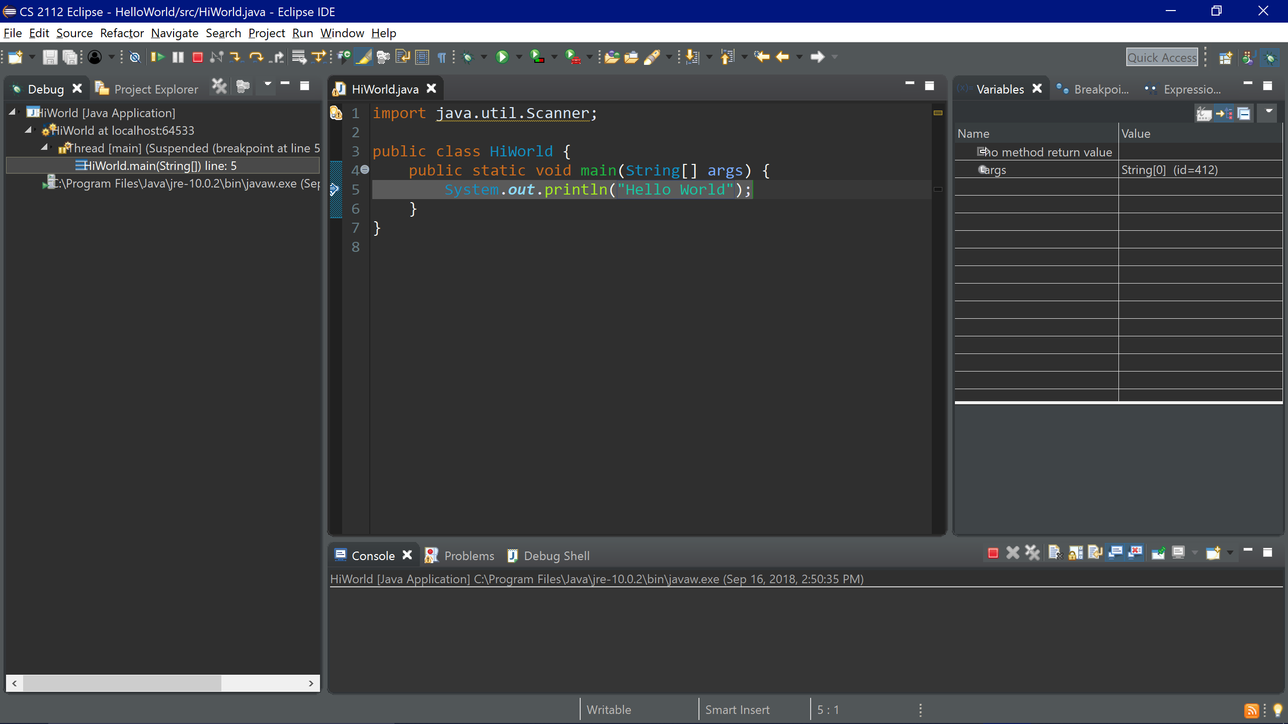
Debug View
You can enter debug view by clicking the bug icon next to Run. Debug view allows you to add breakpoints, step through individual lines of code, inspect variable contents, and test expressions to see their results.
To exit debug view, choose Window:
→ Perspective → Open Perspective → Java

Slide 37
Debug Exercise
Write JUnit test to ensure your solution maintains the class invariants in Lab03.java. Then use debugger to fix any bugs you discover

Slide 38
End of Chapter 3

